Slide 1
Java 21 - Virtual Threads
Wed 13 Nov, 2024
Ario Afrashteh

Slide 2

Ario Afrashteh
SE & Java Chapter Lead @ Rabobank - Digital Platform
github.com/coditori linkedin.com/in/coditori
linkedin.com/in/coditori

Slide 3

Outline
Threads
Reactor Flux/Mono
Virtual Threads
Benchmark

Slide 4
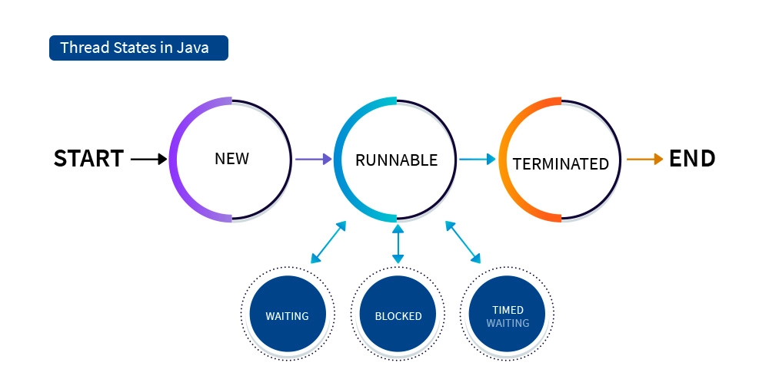
Platform Threads (depends on OS)
Easy to understand
Easy to debug
Supported in Legacy Systems
High Resource Consumption
Blocking Nature
Scalability Limitations (Thread pool scale up/down)

Slide 5
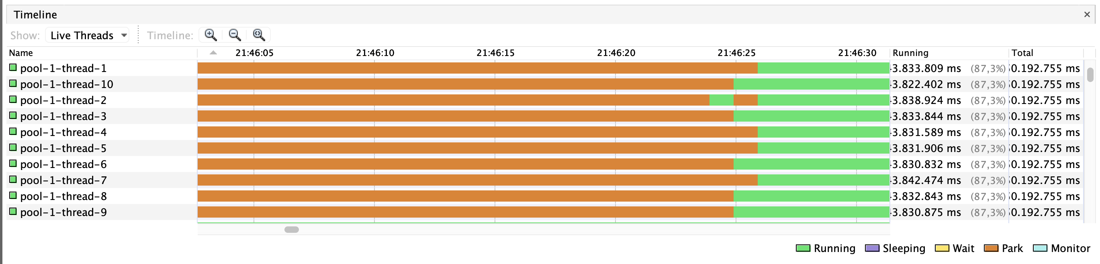
Threads in VisualVM

Slide 6
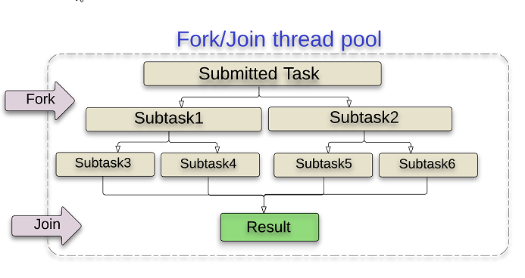
Reactor (Flux, Mono)
Non-Blocking
High Concurrency with Fewer Resources
Event-Driven
Complex Code (async flows/callbacks)
Challenging Debugging/Tracing
Less effective in CPU-bound tasks

Slide 7
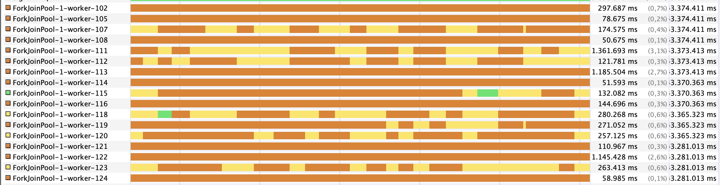
ForkJoinPool in VisualVM

Slide 8
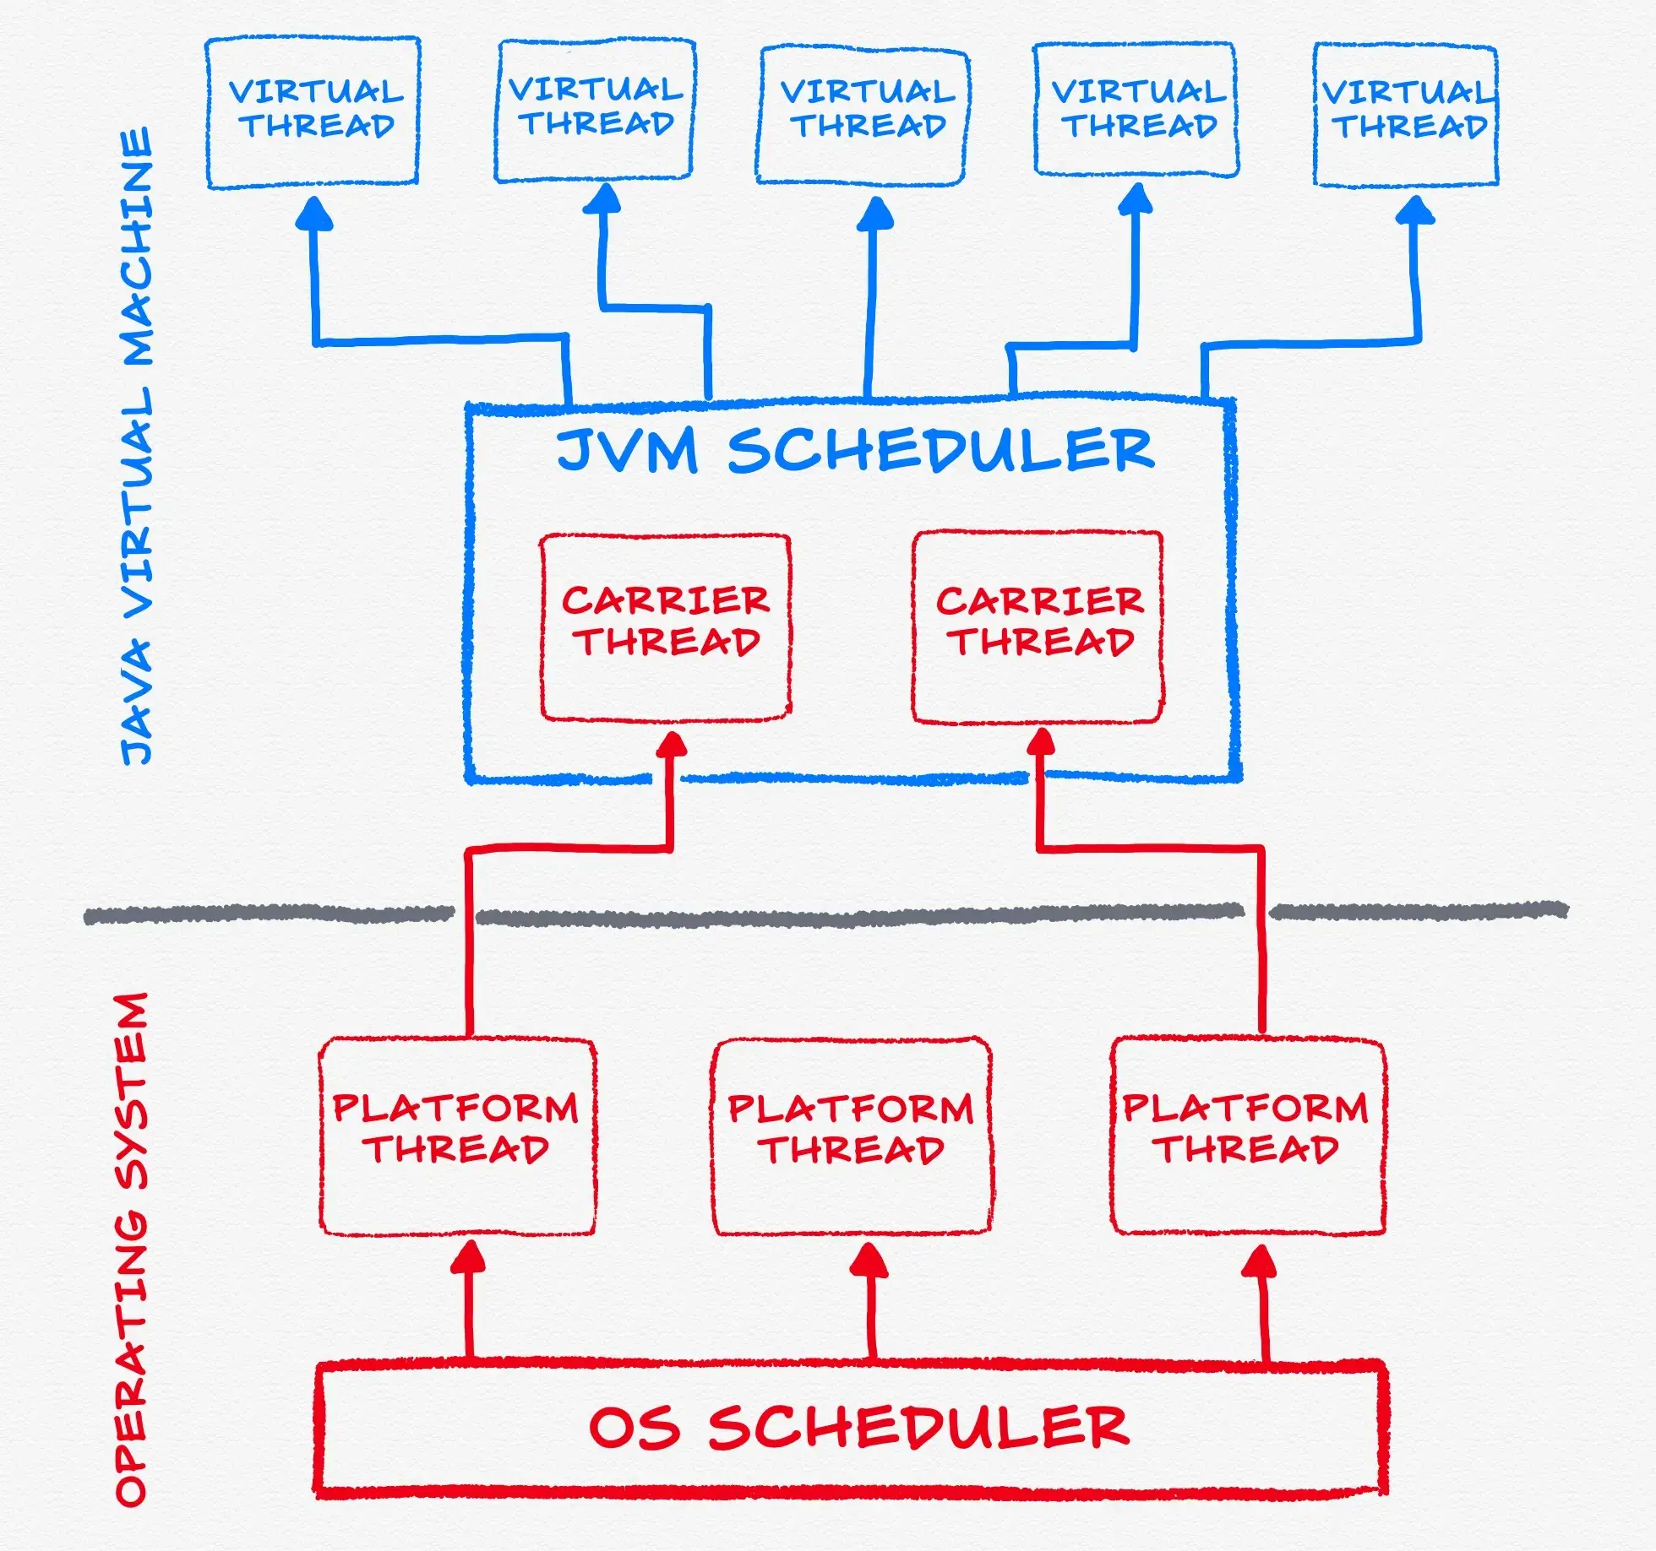
Virtual Threads VTs are Objects in the Heap!
Lightweight, Scalable
Simple code with Non-Blocking
Reduced context Switching
Immature (some of libs are not compatible with it)
Less effective in CPU-bound tasks

Slide 9
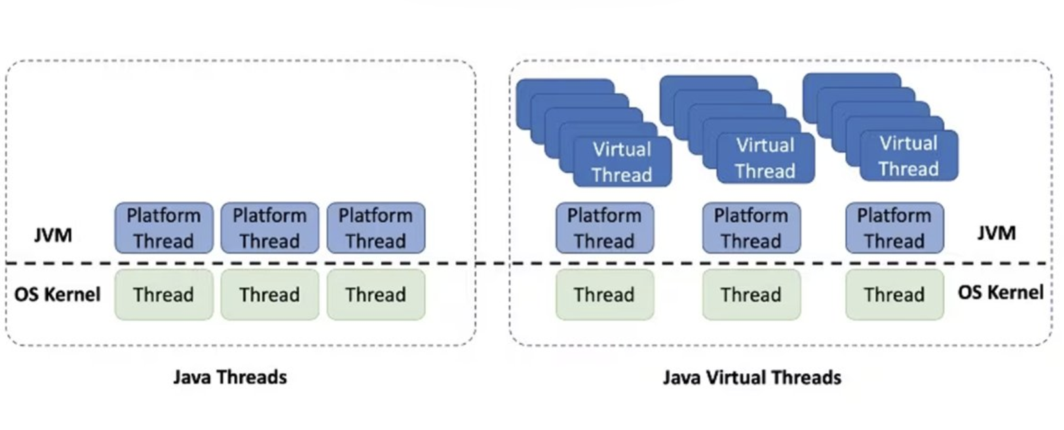
Threads vs Virtual Threads

Slide 10
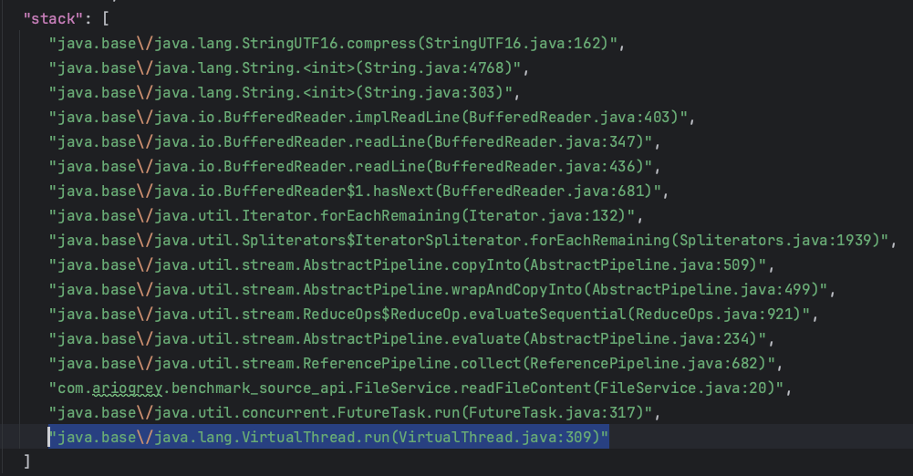
VirtualThread jcmd <pid> Thread.dump_to_file -format=json dump.json

Slide 11
Demo (reading a 6MB file)

Slide 12
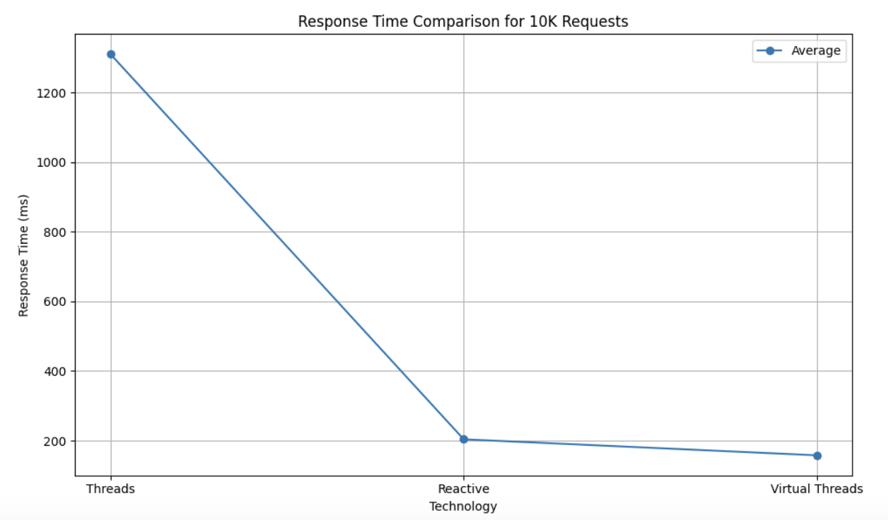
Benchmark (10k reqs) Throughput: 51/sec

Slide 13
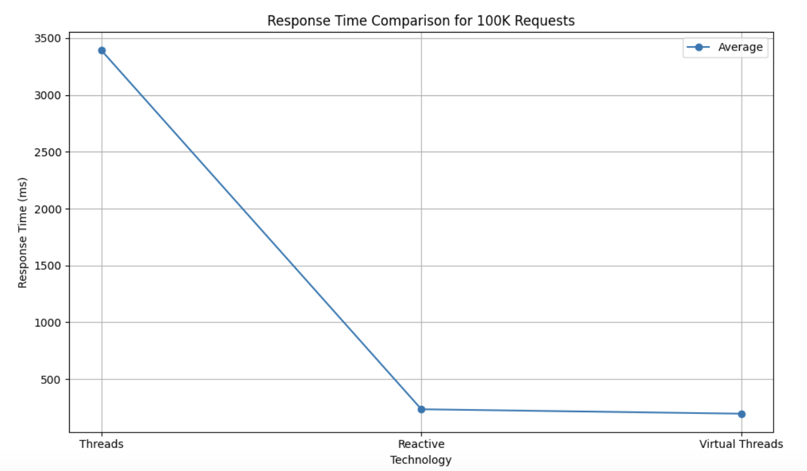
Benchmark (100k reqs) Throughput: 53/sec

Slide 14
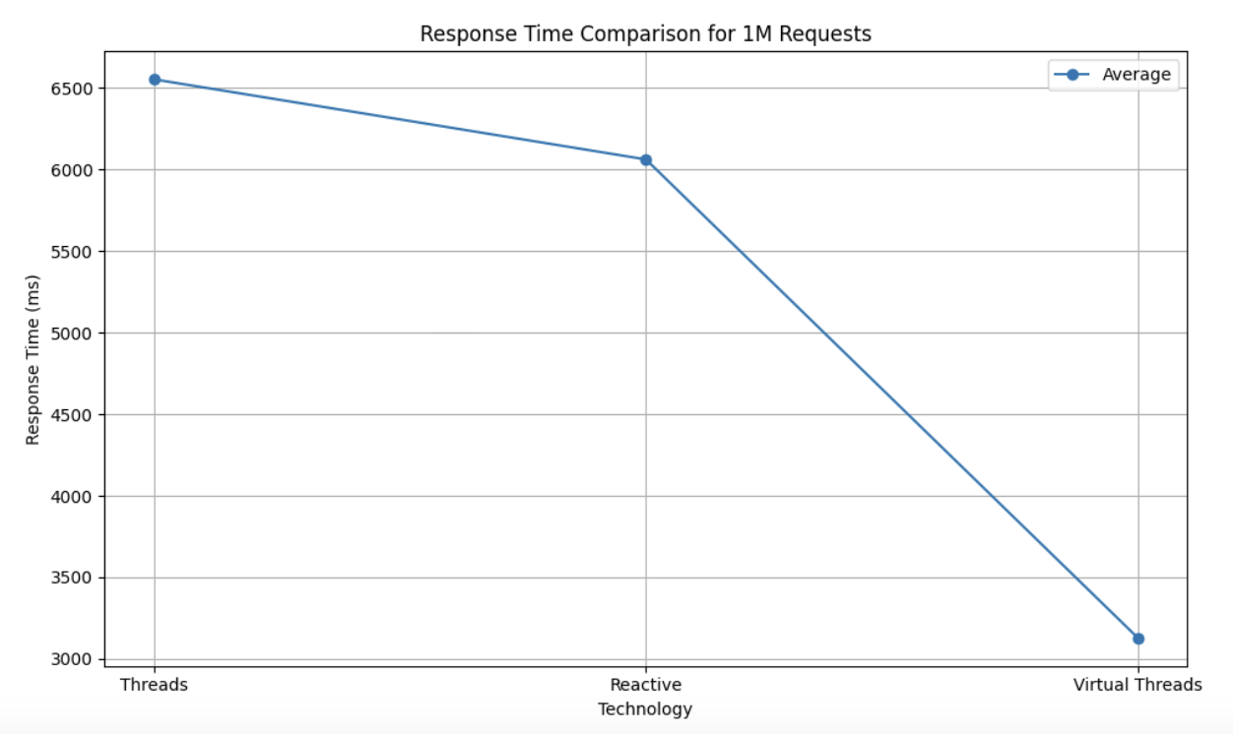
Benchmark (1M reqs) Throughput: 23/sec

Slide 15
Conclusion
Virtual threads let the JVM handle scheduling and switching between threads to prevent blocking OS threads, allowing for high concurrency with minimal OS overhead. This isolates thread management within the JVM, making it more efficient and scalable.

Slide 16

Thank you for your attention!
Questions?

